Slide 1
Employee Performance Analysis
PRESENTED BY. M.Priyadharshini
REG NO. 312214933
DEPARTMENT: Commerce
COLLEGE: Annai Veilankanni’s for women

Slide 2
AGENDA
PROBLEM STATEMENT PROJECT
OUR SOLUTION AND PROPOSITION
MODELLING APPROACH
DATASET DESCRIPTION
RESULT AND DISCUSSION
CONCLUSION

Slide 3
PROBLEM STATEMENT
MANAGEMENT DATA
ORGANISATION
ESAY DATA
AUTOMATION
COLLABORATION
EASE OF USE VERSATILITY

Slide 4
WHO ARE THE END USERS
EMPLOYEES
ORGANISATION FIRM
BUSINESS
HUMAN RESOURCES
MANAAGER
CUSTOMERS

Slide 5
MODELING APPROACH
DATASET KAGGLE, EMPLOYEE DATASET
FEATURE SELECTION
FORMULA-PERFORAMANCE (LOW,MEDIUM,HIGH)
DATA CLEANING-MISSING VALUES, IRREVERENT THINGS REMOVED
PIVOT TABLE- SUMMARY NAME,GENDER, EMPLOYEE TYPE,WORK LOCATION
CHART-REPORT, LICENCE

Slide 6
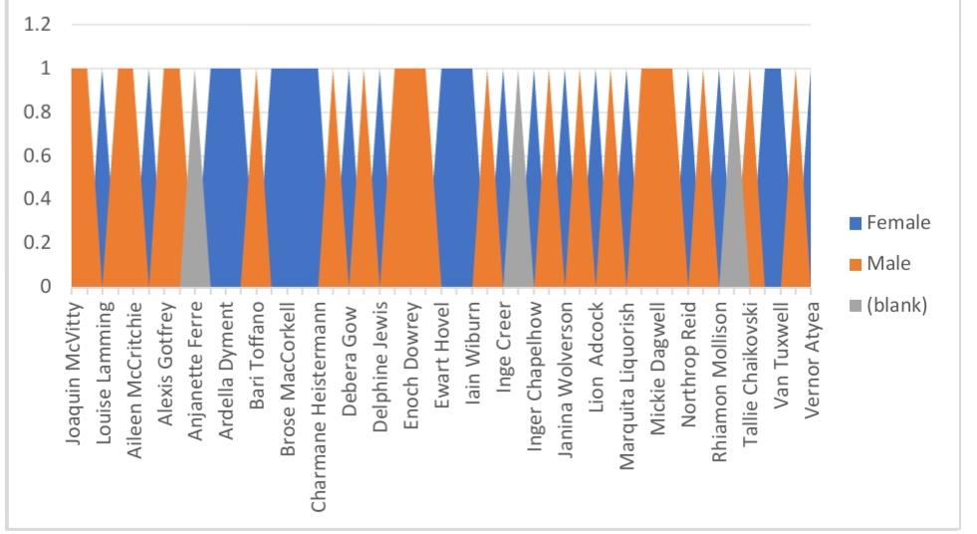
RESULTS

Slide 7
Conclusion
IN THIS PRESENTATION CONCLUDE
BOOST EMPLOYEE ENGAGEMENT AND PRODUCTIVITY
OPTIMIZE TALENT DEVELOPMENT AND RETENSION STRATIGIES
ACHIVE A COMPATITIVEEDGE IN THE MARKET

Slide 8
THANK YOU

